Slide 1
Data Gathering for Customer Insight
Martin Colbert

Slide 2
Contents
Customer Insight
Techniques: WHY and WHEN to use them. Also How to Adapt
focus groups
diary keeping
interviews
questionnaires
Naturalistic observation in the field
Co-ordination and Situated Action lecture
card sorting
Covered in persuasion/credibility and practical exercise
observational grids/checklists, verbal protocols, data logs
covered in UxD(systems)
General Issues
user participation
‘Pilots’ or ‘rehearsals’ for practice and fine tuning

Slide 3
Why Gather Data? Customer Insight to Identify New Opportunities
We want deep explanations of observed performance that support innovation
Identify motivations, experiences and contextual drivers
Detect signals that Customer Insight and Qualitative Research is needed
Behaviour that suggests an unsatisfied need
Key Performance Indicators (KPI)

Slide 4
Signals of Opportunities for Innovation: Suggestions of Unsatisfied Needs
End-user adaptation and configuration of technology
Bookmarks on toolbar
Write macros

Slide 5
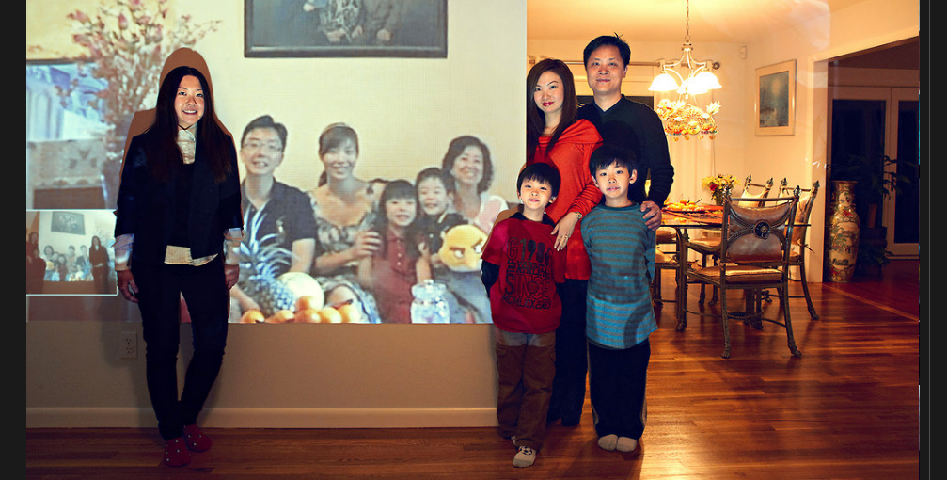
Signals of Opportunities for Innovation
Re-purpose skype to take traditional family portraits

Slide 6
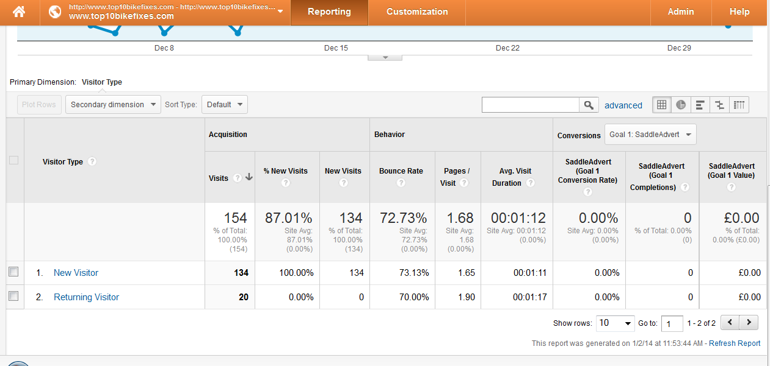
Signals of Opportunities for Innovation: Trends & Distinctions in Key Performance Indicators
a distinction
e.g. mobiles have higher bounce rate
E.g. return visitors bounce less and explore deeper

Slide 7
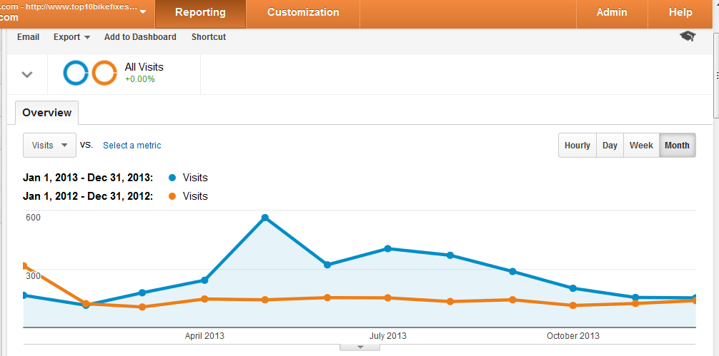
Trends & Distinctions in Key Performance Indicators
A trend
E.g. more visits on sunny weekends
E.g. more visits over the summer

Slide 8
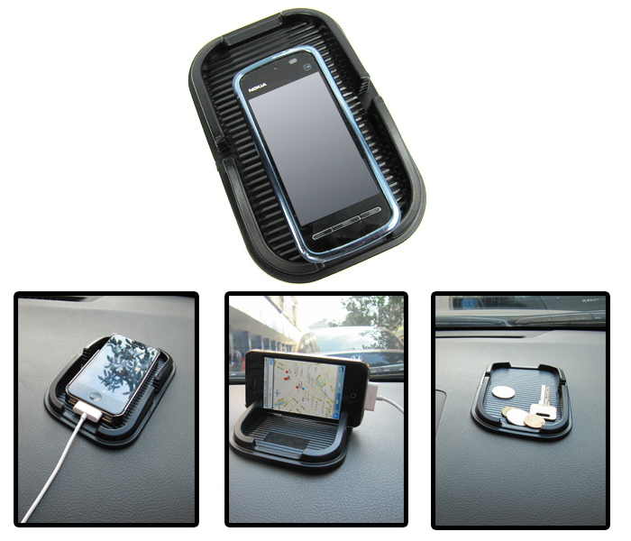
Signals are Always there: Continuous Evolution of User Goals and Contexts of Use
A new resource
Keep it safe
Drive safely
then,
Charge it
Use it as music centre, sat nav, money, authentication

Slide 9
Co-Evolution of Tasks and Artefacts - there is always an opportunity for insight (Carroll)
users wish to behave in a certain way, to achieve certain work goals
a computer is developed to support these behaviours and goals
users perceive new ways of behaving, and new goals to achieve
a new computer is developed to support these new behaviours and goals
and so on. Ux Design enables evolution.
design
Task Artefact
analyse

Slide 10
Co-Evolution of Tasks and Artefacts
task artefact
Business Talk mobile phone
time is money
Teenagers secret gossip sms
my phone is not in the hall
Incomplete co-ordination tracking?
“See you Saturday”

Slide 11
Data Gathering Techniques
Focus Groups
Diaries
Interviews
Surveys
Expectation
Core procedures
Variations conducted to deliver the information needed, given the concerns within the project constraints

Slide 12
Focus Groups
a small group of users comment upon specific aspects of actual or potential systems and their relations to it
a moderator sets the agenda for discussion, and encourages appropriate contributions from all participants
may encorporate various props (pin boards), devices, demonstrations, ‘presentations, tasks to create a shared context for the discussion and enable expression.
used for: qualitative insight, user-led issue raising and direction setting. Customer feedback. Joint design of scenarios. Starting background framework construction. Place, price, place, promotion i.e. Product Opportunities .
bad for: systematic consideration of well-structured alternatives, all the details that set a product in it intended use

Slide 13
Guidelines for Moderators
Be personable
Ask questions
Have sufficient domain knowledge (what is important, what not?)
Stay focused
Avoid behaving like a participant
Keep the activity moving
Keep the participants motivated/encouraged
No critiquing
Everyone should participate (☛ use “round robin”)
No one should dominate

Slide 14
Focus Group
Issues
suggestion by moderator – remember participants want to please you
“How would you describe using this?” (not “What’s difficult about this?”)
Stick to what users know e.g. what is perceived as fun or pleasing or popular. Judging actual ease of use may be more difficult, because users do not remember everything they do, and may be too forgiving/too harsh
moderator workload – talk and record, and document later, or have a moderator and a not-taker
Moderation of emotionally charged conversations

Slide 15
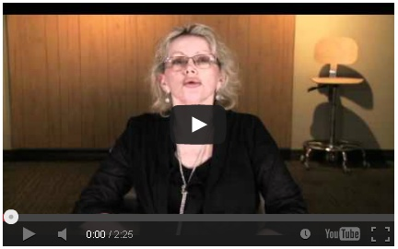
Mom gives feedback on 18+ computer game
http://www.youtube.com/watch?v=1CKqbmMvHE8&feature=player_embedded
How well does the moderator do?

Slide 16
Example: Focus Troupes (Intel)
20 people at tables seating 4-5, total 2hrs
Introduction
6-10 min Dramatic vignette demonstrates how the product might be used in a familiar scenario
Structured conversation, opened by monologue
White hat –more information and clarification
Green hat – possibility comments
Black hat – negative comments
Red hat – emotions and feelings
Yellow hat – positive constructive
Blue hat – controls the process

Slide 17
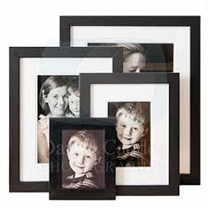
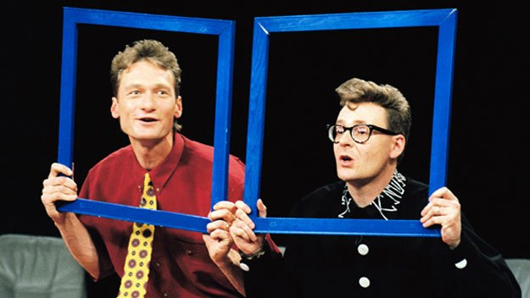
Improvisation
Flexible
Focusses upon behaviour
Portraits are on everyone’s desks
What interactive, networked picture frame from skype could we do with

Slide 18
Variations
Use the same script but change the attitude or emotion –explore range of situations
Have same person play all the roles – to see how roles affect products and vice versa
Act out an everyday situations and add a constraints – see the difference when a situation changes
Act out what goes on inside and outside a product – the users’s mental model may not be accurate
An actor is the product – how would you interact with it?
Use a product , pass it on and think of another to reveal uses
Build on another’s story about using a product to reveal unexpected scenarios of use

Slide 19
Focus Group
Issues
group dynamics
Personality clashes, disagreements, or status differences may suppress contributions from some participants, or exaggerate feelings
Counter the risk of “Groupthink” by:
- separating ‘problem pairings’
e.g. the boss and the subordinates
- structuring and supporting that structure
e.g. you say that you will involve everybody in the Introduction talk, and then the session ... take turns, consider pros then cons,

Slide 20
Issues
invitation of participants
How will this particular mixture of individual get on? What will be the dynamic?
E.g. Bike lifers, sports cyclist and parents – may have different perspectives on the topic, and exposure to alternatives may distance participants in the focus group. Best one group per persona
E.g. Admins, nurses, doctors and patients – all have different perspectives on the topic, but exposure to alternatives may stimulate a longed for exchange and feedback about the implications of one work role for another. Best mixed groups

Slide 21
Diary Keeping
the user documents events, soon after they happen
include images/video clips from digital cameras/scanners to document actual objects and contexts of use
Good for:
recording events that are difficult to observe (rare, personal, mobile). Exploring range and frequency of tasks, work objects and contexts of use.
Bad for:
objective quantitative data; definitive specifications

Slide 22
Diary Keeping
Big Issue
participants may not collect data completely/systematically and capture all relevant information
How to ensure full reporting
Format the diary: headings, tables,
Support/supervision: e.g. by telephone. “How was diary keeping this week?”. Review and complete the record
How much to tell participants about the hypothesis? Too much biases the response, too little and potentially relevant information is not included
How soon after the event is the diary completed? As soon as possible. It depends upon how memorable the events are.
augment with other techniques: interviews, questionnaires

Slide 23
Example: A Diary about Rendezvousing
for each rendezvous the participant:
Gave a 5- 10 line free text description of what happened
answered 14 questions (Q1-14) about the rendezvous itself (who, when, where, what for, success/failure, and if failure then the value of the lost opportunity, and the reasons for failure
answered 12 questions (Q15-Q27) about the effectiveness of communication
a further 5 questions (Q28-32) about tracking services

Slide 24
Example: A Diary about Rendezvousing
Strengths
??
Weaknesses
??
Criteria:
Encourages participation
Clear relevance criteria
Supports expression
Requests Known info
Supports remembering
Assess the example on study space rendezvous diary.doc – what is wrong with this draft?
??
Weaknesses
??

Slide 25
Example: A Diary about Rendezvousing
Strengths
Questionnaire is easy to complete, and verifies event report in free text
Can put a number to some diary entries
Weaknesses
Long!
When will the participant complete it?
Complex – if participants used e-mail, phone and text message, which conversation was the problem?
Any insight is in the free text, so better put it first

Slide 26
Interviews
Good for
eliciting qualitative descriptions of tasks/work/context of use.
Follow-up/clarification. Disambiguating and contextualising observations.
purpose
what information do you wish to obtain or confirm?
select interviewee and type of interview
focussed (explore issues raised by a topic)
structured

Slide 27
Questions
Exploratory
Opening, and follow-ups. Vary one element, or re-start, with key phrases. Ask for explanations?
Opener: “Last time to you met up with your friends and family, what happened? How well did you meet up?”
Follow-ups: “Do you always meet then/there?” “Are there occasions when you meet up differently?” “Why was that the way it happened?” Was that an easy or difficult decision to make?”
“That’s great. Can we talk about another occasion now? Do you sometimes meeting up with other friends for other reasons?”

Slide 28
Questions
Structured
a set sequence, with a logic
“When you meet your friends at the weekend, what is your attitude towards being on-time?”
“What factors guide your expectations in relation to being on time?”
“When is it appropriate to reveal your current location to someone you are meeting?”
“When is it appropriate to not disclose your current location to someone you are meeting?”

Slide 29
Variations
critical incidents
ask the interviewee to tell revealing stories
‘M Poirot, please tell me about your most difficult case’
problem-solving
set interviewee a problem, and they tell you how they would solve it
‘The chain is slipping off the cogs – what should i do?”

Slide 30
Variations
in context of a device, or a task, “probes”
pictures of events, documents, pin boards of issues
Prototypes: walkthroughs (guided), free tasks
Revisit each step or each component they used.
“What did you make of that?”
“What did you expect to see?”
Prepare an ‘Interview Guide’
Everything you need to know and use to conduct this interview (aims, participants, questions, props, context, moderation proceure)

Slide 31
Interviewing Issues
as scripted (systematic) and yet also natural (situated, immersed, uninhibited)

Slide 32
Questionnaires
Good for:
Frequency of alternative responses. Describing users/selecting participants. Summarising user experience.
Bad for:
Letting users speak for themselves

Slide 33
Questionnaire
formulating questions
ask for a single piece of information per question
be specific
be understandable
No jargon, avoid ambiguous phrases, include notes if necessary
avoid leading or biased questions
only ask for what the informant knows
do not ask hypothetical questions
include ‘null’ response options, rather than make assumptions
The answer option ‘none’ or ‘not applicable’
consistent and intuitive layout
data entry ‘slips’ or omissions can occur if responses are not aligned
‘very convenient’ is a high number

Slide 34
Questionnaire
agreement
Probe: A statement
Response: Agree, Disagree or Don’t Know
rating scales
5 or 7 point, single dimension/concept, units on scale are of equal magnitude, neutral middle point
very somewhat neither interesting somewhat very
uninteresting uninteresting nor unintersting interesting interesting

Slide 35
Questionnaires
standardised “benchmark” questionnaires are better for late, ‘summative’ evaluation.
SUS Standard Usability Score – 10 ratings
SUMI Software Usability Measurement Inventory assesses the perceived quality of use of all kinds of software
dimensions are independently varying and generally applicable: Global, Efficiency, Helpfulness, Affect, Control, Learnability
50 questions many questions probe for rating of single dimension
Has been validated – gives the same assessment as a panel of experts

Slide 36
Questionnaires
Formative questions elicit perceptions and preferences
If there is a limited set of possible answers, list them
“When using your personal e-mail account at home, what kind of device do you use most frequently: mobile phone, tablet, laptop, desktop?”
Are response options mutually exclusive (radio buttons), or multiple alternatives (check boxes)

Slide 37
Observation: Naturalistic Field (communication analysis/ ethnomethodology)
Listen to and watch users “in the wild”
a precise record of ‘speech’ and ‘movement’ of
all vocalistions (not just words, but also grunts, pauses in speech)
all gestures (not just posture, but also focus of orientation in environment)
pronunciations (and dialects)
relative timing
emphasis (volume, intonation)
certainty - if the tape was inaudible, unclear or ambiguous
produce a transcript
describe the activities, sequence/parallism
Wait for patterns and regularities to emerge

Slide 38
Good for
Revealing the motivations and meanings of actual behaviour (power, status, relationship). Identifying the habitual structure (practices) of actual behaviour
Issues
How can you ensure observations are not mis-interpreted? Become a user yourself
Observation may distort behaviour we think is ‘natural’

Slide 39
Technique Selection Quiz
Gather data to answer to following questions:
How should information be organised on a shared workspace for sales and marketing personnel?
What new features might benefit heavy users of an online auction site?
What information does a Registrar need to forward details of a dead person onto the relevant departments?.

Slide 40
General Issues: Rehearsal
It is necessary to try out your data gathering activity before you collect any data:
to fine tune your materials and procedures. Unless you are using a standard technique, it is almost impossible to anticipate:
all possible interpretations of questions and answers/ behaviours
how long it takes to complete activities
whether participants have enough information about the activity
the moderator’s performance must be correct and consistent. Timing and confidence is important.

Slide 41
General Issues: Verification
Check you understood
After the session, summarise important information, and return it to participants for feedback
Participants may feel responsible for providing you with information, especially if they are ‘active members’ of your development team or ‘domain experts’

Slide 42
Development Team Participation
User study is an opportunity to raise awareness/interest/appreciation of importance of user experience issues in your own organisation
Invite ‘friendly’ ‘helpful’ developers to participate as participants/designers (co-design session), audience, experts (“how does this beta-version actually work?”), technical support

Slide 43
General Issues: How many participants?
To discover ‘most’ of the problems, 3-5 of each type. To be certain, around 10 of each type.
But how many kinds of user, task and context of use does your problem concern?

Slide 44
Tools for Remote Data Gathering
Faster information, from actual users
Mural.ly – collaborative multimedia pin board
Ethn.io – pop-up recruitment form
Survey Monkey – remote survey
Skype, Google groups – video-conferencing, screen share
Heyday/Saga – life logging/journaling apps
Jive – community manager and forum (discussion areas, polls, blogs, file share, image share)

Slide 45
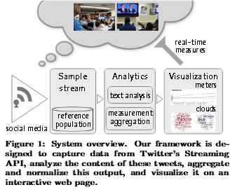
Sentiment Analysis: Computational Focus Groups?
Tweet streams
Free-form responses embedded within everyday social contexts, and associated with real events and information
Count positive or negative adjectives
Adjust to the context of the individuals : e.g. Tweeting frequency, use of adjectives,
E.g. New iPhone released – why did people buy it, how did they find it initially, how does their reaction change over the coming months

Slide 46
Card Sorting
Collect actual items, or label cards with item name
ask participant to group items according to rules
Either, the designer provides a rule for the participant to follow,
or
ask the participant to sort the cards and then elicit the rule the participant was following
various sequences of grouping together, sub-dividing, re-grouping etc.
good for:
distinguishing categories and concepts, identifying similarities and differences.
See persuasion and information architecture lectures

Slide 47
Observation: Controlled Lab. (Grids/Checklists)
- select user, task and context
representative, typical, critical, unusual, problematic
gather data
ask user to perform a task, and observe. Get video- or audio- recording,
analyse data
during/after (1hr of video takes 10 hrs to analyse)
Good for:
State usability problems, exactly and show them to others, justify design goals, discover actual frequencies. Obtaining quantitative data

Slide 48
Example: Helpline Grid/Checklist
ways of reducing speed and increasing satisfaction by performing sub-tasks in parallel
Monday am - busy period, the advisor said to be the “best”
mis-typed query name

Slide 49
Observation: Sensors
Wire-up users to collect Heart Rate, and Galvanic Skin Response – physiological indicators of psychological states, such as stress, workload
Eye-trackers monitor participant’s gaze. Popular in web-sites – how much attention exactly do certain features attract?

Slide 50
Verbal Protocol
ask user to perform selected task scenarios, and to talk aloud as they go and tell you what they are thinking
may be hard work for users - two tasks, and making reasons for actions explicit is not natural for everybody
designer prompts the user to keep talking, and guides the user through task as required
“What are you doing now?”
“What’s happening now?”
“What do you think this is about?”
“What did you think was going happen?”
Good for:
Stating and explaining user interface design issues.

Slide 51
Verbal Protocol
if too noisy, intrusive or difficult protocols may be taken retrospectively with the user watching a video recording of themselves

Slide 52
Data-Logging
time stamp of interactive event and/or object properties obtained by changing code in application
scope: all vs. selected user interface events (a limitation)
output: text file, hidden field, spreadsheet
increasingly easy with analytics for web sites
Cut and paste javascript ‘snippet’ into web html
Good for: quantitative data. Objective record of events

Slide 53
Data Logging Tools
Website Analytics
Google Analytics (as you, level 1)
Clicks per page
Click per target action
Click streams/funnels
Exit points (show ‘in page analytics’ view)
Inspectlet.com (as you, level 2)
Screen captures (http://www.inspectlet.com/dashboard/watchsession/1466036048/4008434426?pn=1&accessResourceKey=44be727fbf633f2ba3cf574129754940646ef925)
Heatmaps e.g. Top10bikefixes.com (home page only)

Slide 54
Technique Selection Quiz
Gather data to answer to following questions:
Does the context of use effect user experience of clam-shell and ear-piece style mobile phones?
How do city traders collaborate in the buying and selling financial products ?
Is GIMP difficult to learn, and if so, then what features are most difficult, and why are they difficult ?

Slide 55
The Big Issues
Quality of data gathered is only as good as quality of participant selection, planning, preparation and execution
What do I really want to learn about exactly?
How else could I obtain the information I need? Which approach is best?
What questions should I ask?
Seek thoughtful coherence and consistency, rather than perfection
participative prototyping may compensate for many inaccuracies

Slide 56
Empirical Inputs for Products of Analysis, Design and Evaluation
user journeys
user descriptions
tables of usability reqts
task scenarios
task decompositions
object models
design sketches
paper prototypes
implementations
evaluation reports
focus groups
diary keeping
card sorting
interviews
observation
naturalistic field
structured lab.
verbal protocols
data logs
questionnaires
by selecting, adapting and sequencing techniques, you decide which data gathering event helps you create which product

Slide 57
References
Lazar, Feng and Hockheiser, 2010, Research Methods in Human-Computer Interaction, Wiley.
Sata, S. And Salvador, T 2001, playacting and focus Troupes: Theatre techniques for creating quick intense immersive and engaging focus group sessions. Interactions, september + october 1999, ACM Press.
Damodaran, L., 1996, User Involvement in the Systems Design Process - a Practical Guide, Behaviour & Information Technology, 15(6), 363-377.
Davies, M. & Hakiel, S 1988, Knowledge Harvesting: A Practical Guide to Interviewing, Expert Systems, 5(1) 42-49
McGraw, K. L. & Seale, M. R. 1988, Knowledge Elicitation with Multiple Experts: Considerations & Techniques, AI Review, 2, 31-44.

